Slide 1
AI Forum University of Utah December 10, 2025

Slide 2
Agenda
Authentication and Associated Risks
AI in the Learning Environment
Open AI | ChatGPT Edu Training Opportunities
AI Tool Guidelines
Get Connected
AI Communications
AI Summit Recap
Q & A
Notes:
Manish

Slide 3
Authentication and Associated Risks

Slide 4
AI in Teaching & Learning
Anne Cook, Rob MacLeod, and Jon Thomas

Slide 5

Instructor Resources
•CTE’s AI for Teaching page: https://cte.utah.edu/instructor-education/ai-for-teaching.php
•CTE’s AI 101 course for Instructors: https://utah.instructure.com/courses/941937
•Attend CTE Events/Trainings:
•Spring 2026: CTLE 6960 Special Topics: Teaching with AI
•Schedule an Individual Consultation at https://cte.Utah.edu

Slide 6
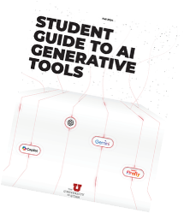
Student Learning
•Clear Syllabus Statements on Expected Use of AI in Courses
•https://cte.utah.edu/instructor-education/ai-for-teaching.php
•Use clear rubrics to help students know WHEN and HOW AI use is ok
•Student Resources
•U Student AI Guide: https://cte.utah.edu/instructor-education/ai-website-content/gen_ai_2024.pdf
•Marriott Library Guide: https://campusguides.lib.utah.edu/AI
•UBOT by the U’s Academic Innovation and Intelligence Lab, in collaboration with The Learning Center

Slide 7
Events
•Every Thursday
•Data Drop-in hours. Marriott Library Level 2 Digital matters
•Every Friday
•AI Office hours. Microsoft Teams
•AI.Utah.edu/events
•CSME: AI in Education
•January 26 Yao Mao (Students’ use of AI during class
•February 23 Tuba Yilmaz (AI and multilingual learners)
•March 23 Nancy Songer (AI in Stem)
•April 27 Janis Louie (Online Teaching and AI)

Slide 8
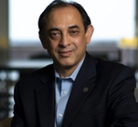
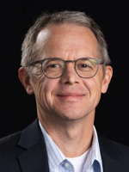
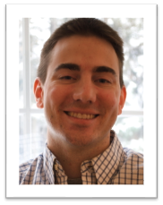

Teaching and Learning in AI Working Group

Slide 9



Teaching and Learning in AI Goals

Slide 10
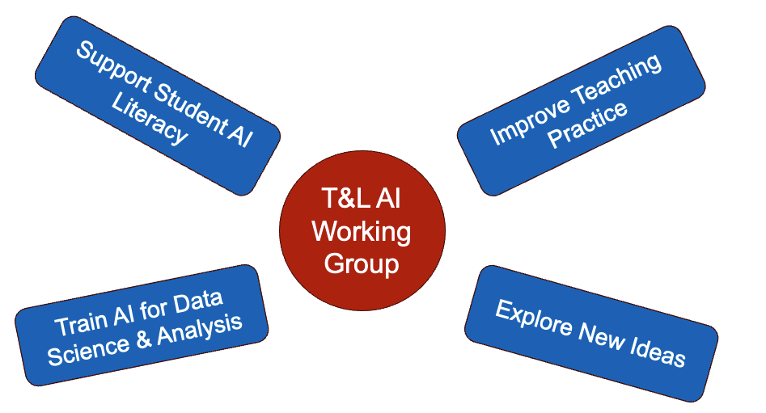
Teaching and Learning in AI Structure

Slide 11
Spring Semester OpenAI | ChatGPT Edu Trainings
Weekly live webinars for ChatGPT Edu
Weeks 1-3: Beginning
Week 4: Intermediate / Advanced
Schedule to be published next week on ai.utah.edu
Recorded sessions will be available

Slide 12

AI Tools
ChatGPT Edu
Students, faculty and staff can request access: University IT’s Service Catalog
Watch for an email with login instructions.
Info & tips: U of U ChatGPT Webpage

Slide 13


Data Safety: Restricted & Sensitive Data are Not Allowed for use in AI Tools
Restricted Data
Sensitive Data
Health & Identity
PHI (patient or clinical data)
Social Security numbers
Driver's license numbers
MRNs, medical identifiers
Financial & Access
Bank account numbers
Credentials, authentication data
Anything protected by law or contract
FERPA protected student information
Academic Records
(grades, GPA, class schedules, student performance data, advising notes)
Identifiers (UNIDs)
Enrollment details
Employee personnel information
Non-public research information
Internal assessment, draft budgets, or strategy documents
Notes:
Please follow data protection practices to keep everyone safe.

Slide 14

Public Data: Safe to Use in AI Tools
Public websites
Course catalogs
Synthetic or fully de-identified examples
General teaching materials
Published research
Public reports, policies, and program descriptions
Generic workflows and process descriptions

Slide 15


AI Office Hours: Join us!
Questions or suggestions about the use of AI at The U?
Drop into virtual office hours
Every other Friday from 12 to 1PM
Microsoft Teams Meeting ID: 237 174 996 299 Passcode: Mm9L6hw7
DEC
19

Slide 16
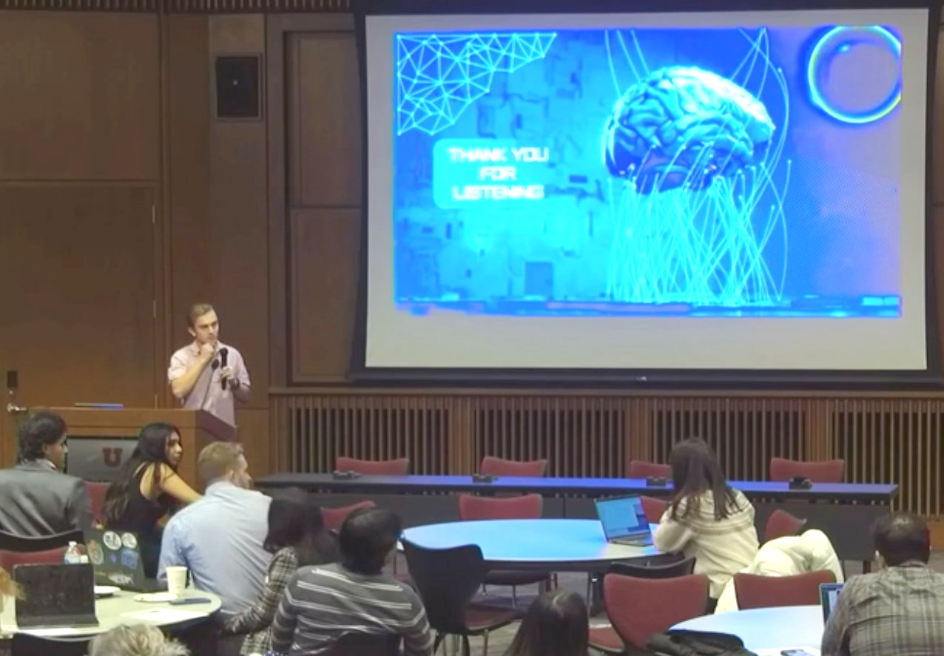
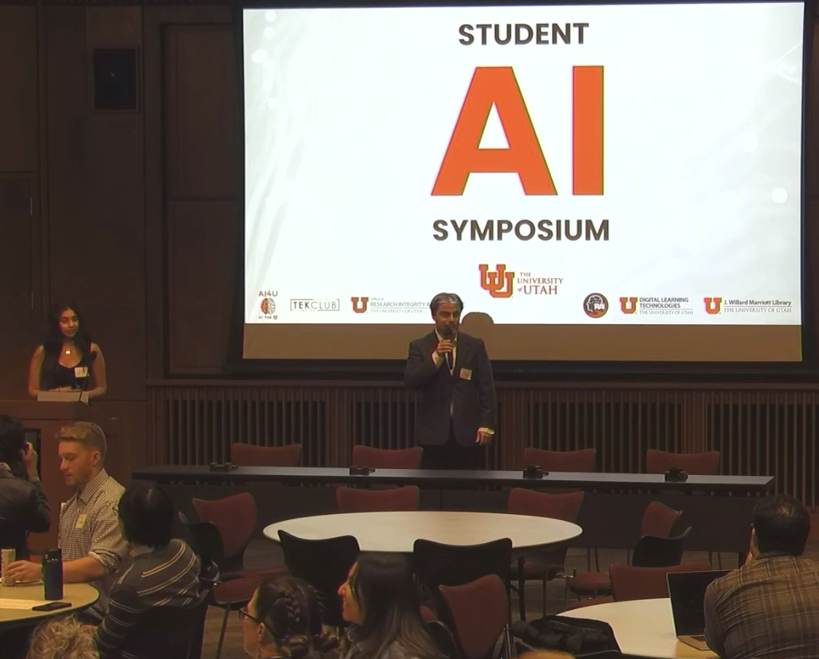
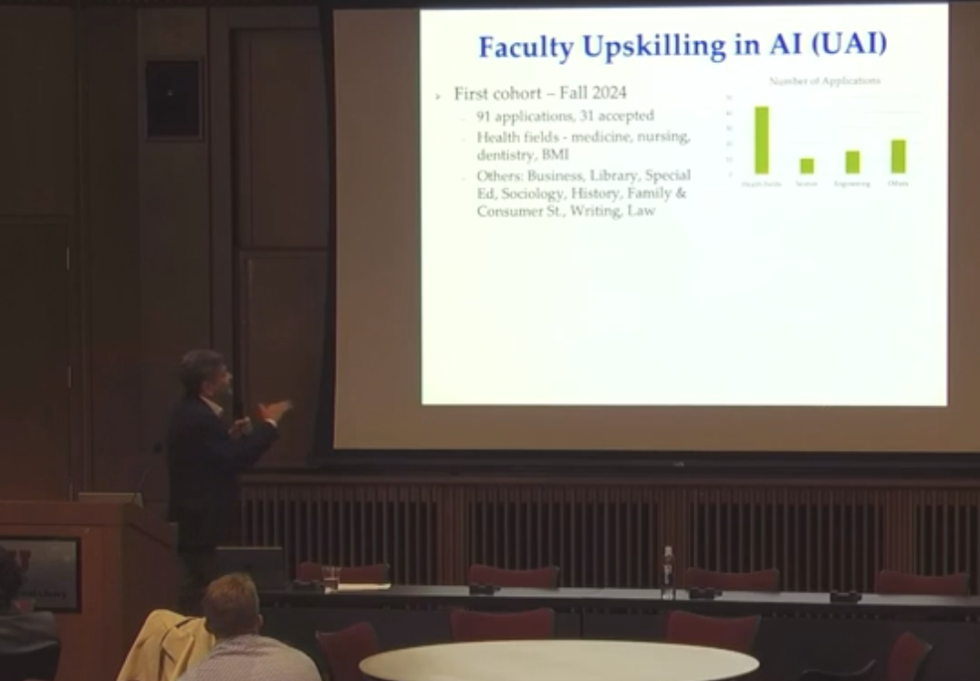
Student-led AI Symposium
Purpose was to showcase how students are engaging with generative AI
Hosted at the Gould Auditorium on Friday, 11/21/25
113 registrants
"Excellent” symposium
Speakers engaging
Need more/varied use cases (addition disciplines)
Would like more about AI tools in use at the UU
Want more faculty involvement
Next symposium will be in 2026 (date TBD)
Let your faculty and students know so that they can participate

Slide 17

AI Community of Practice (ACP)
Host monthly meeting of AI practitioners/users across campus
AI & CTE
AI & Breast Cancer Imaging
AAAI Framework & Use
National Data Platform (NDP)
4th Tuesday of the month at 11:00 AM on Teams
Contact Caren Frost or Penny Atkins to be added to the meetings
Regular information is provided on Teams about AI topics
January 27th topic will be on CHPC & AI
JAN
27

Slide 18
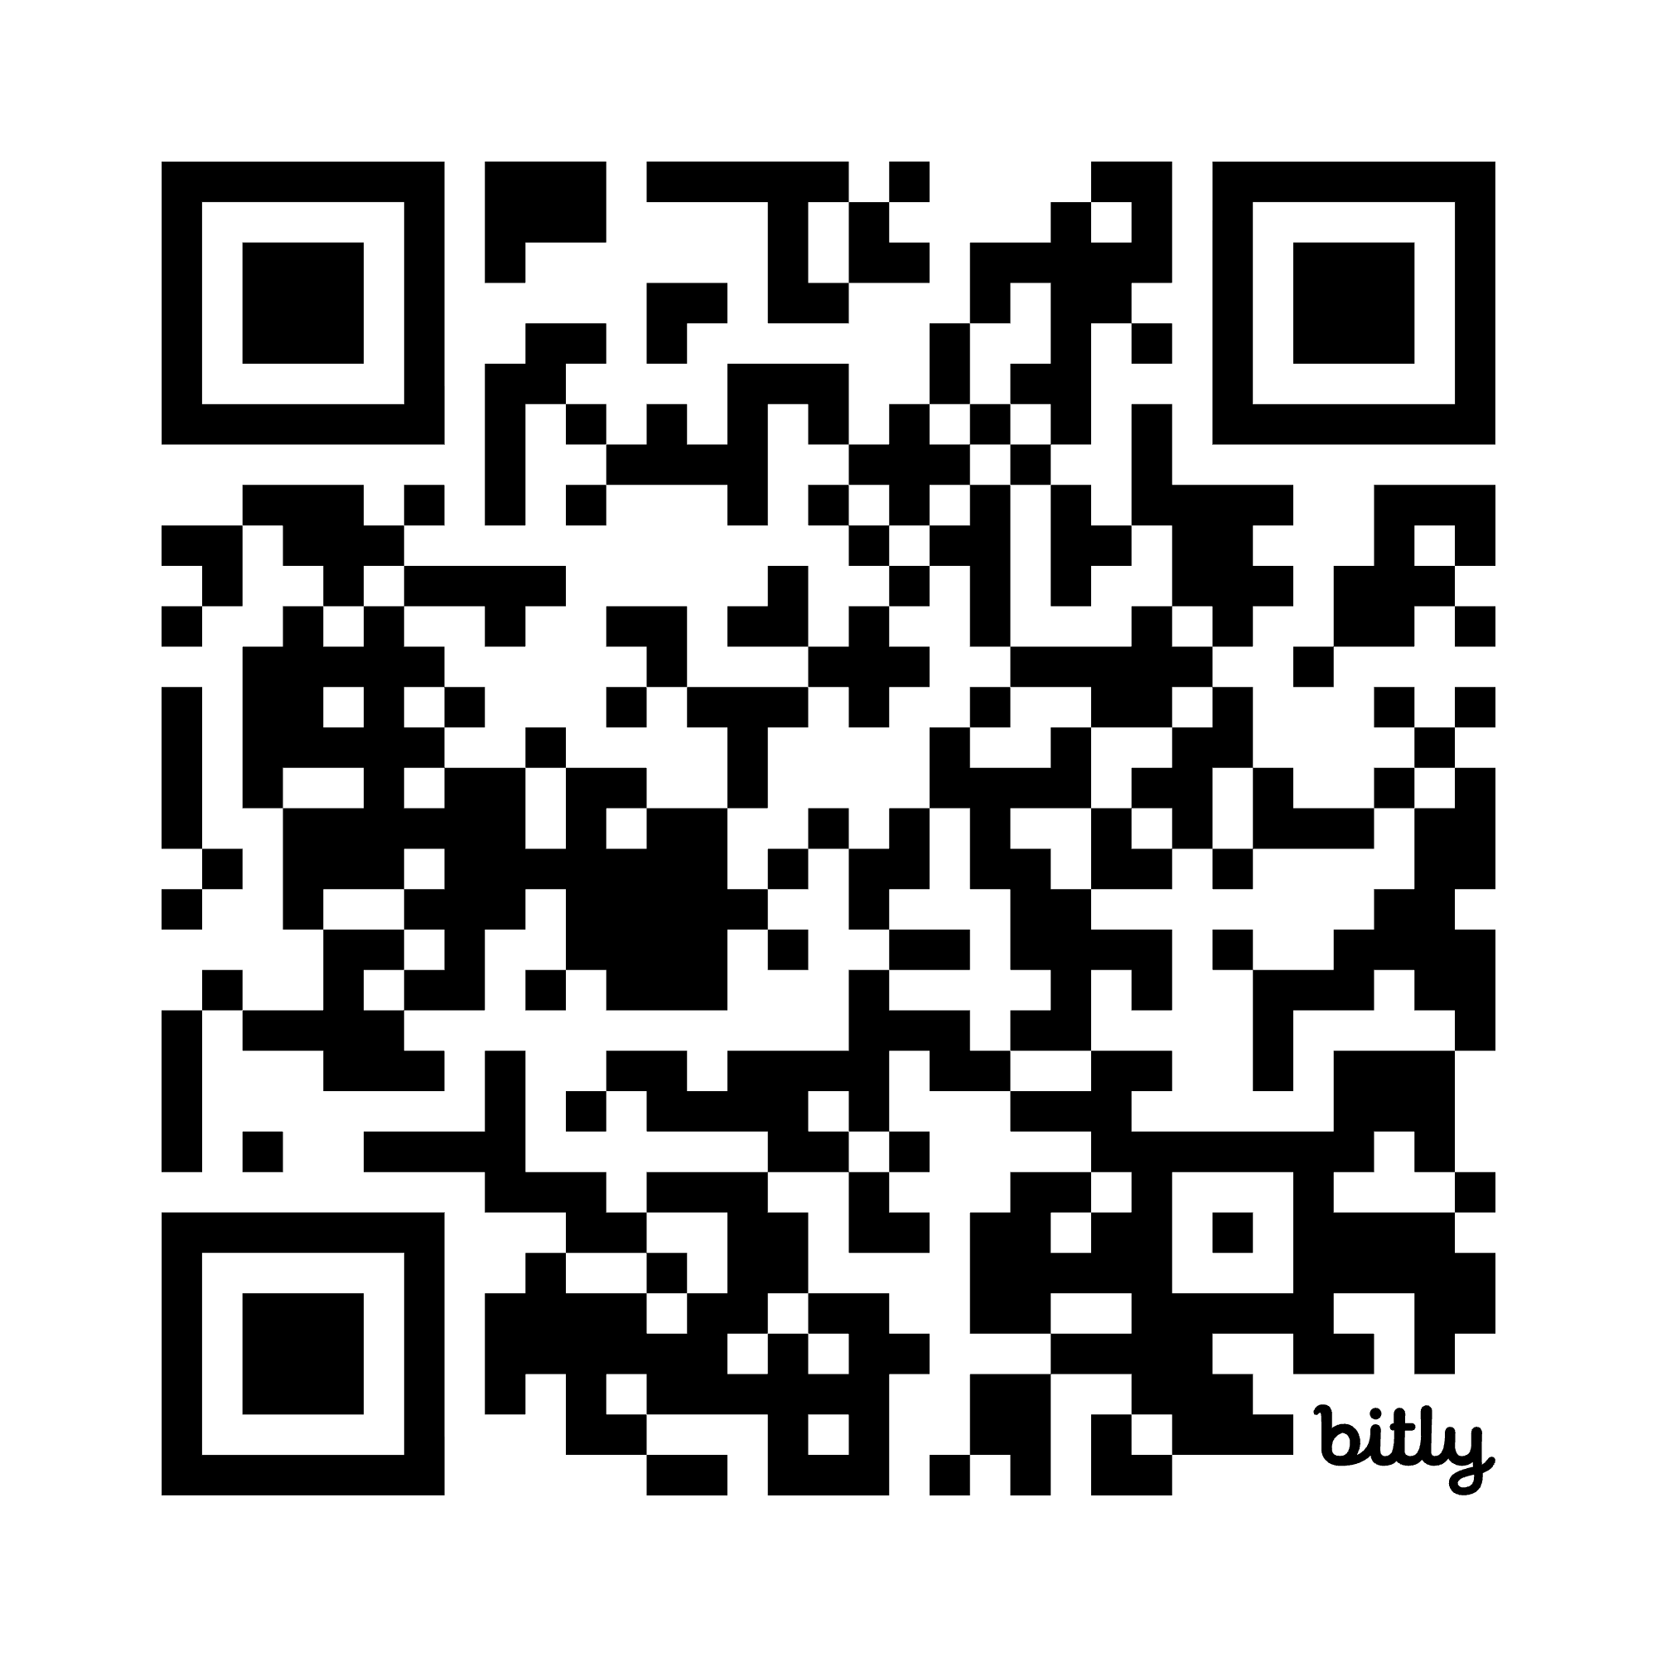
AI Office Email Updates
Sign up for email updates
Scan the QR code or visit bit.ly/uuaiemails
Also a button on ai.utah.edu homepage
If you signed up for this meeting, we’ll go ahead and subscribe you.
The first email will go out next week with a link to the forum recording
Notes:
Manish

Slide 19
NEW WEBPAGE At a Glance: AI at the U
ai.utah.edu/at-a-glance.php
Collaboration with AI Office, Provost’s Office, and UIT web team
Provides a quick overview of what’s going on in AI across the U
AI Office duties
AI research stories
AI-related research programs across campus
Resources from the Martha Bradley Evans Center for Teaching Excellence
AI academic programs for students
Recurring events
Want us to consider adding something? Email kelly.hermans@utah.edu
Share your story!
Notes:
Manish

Slide 20
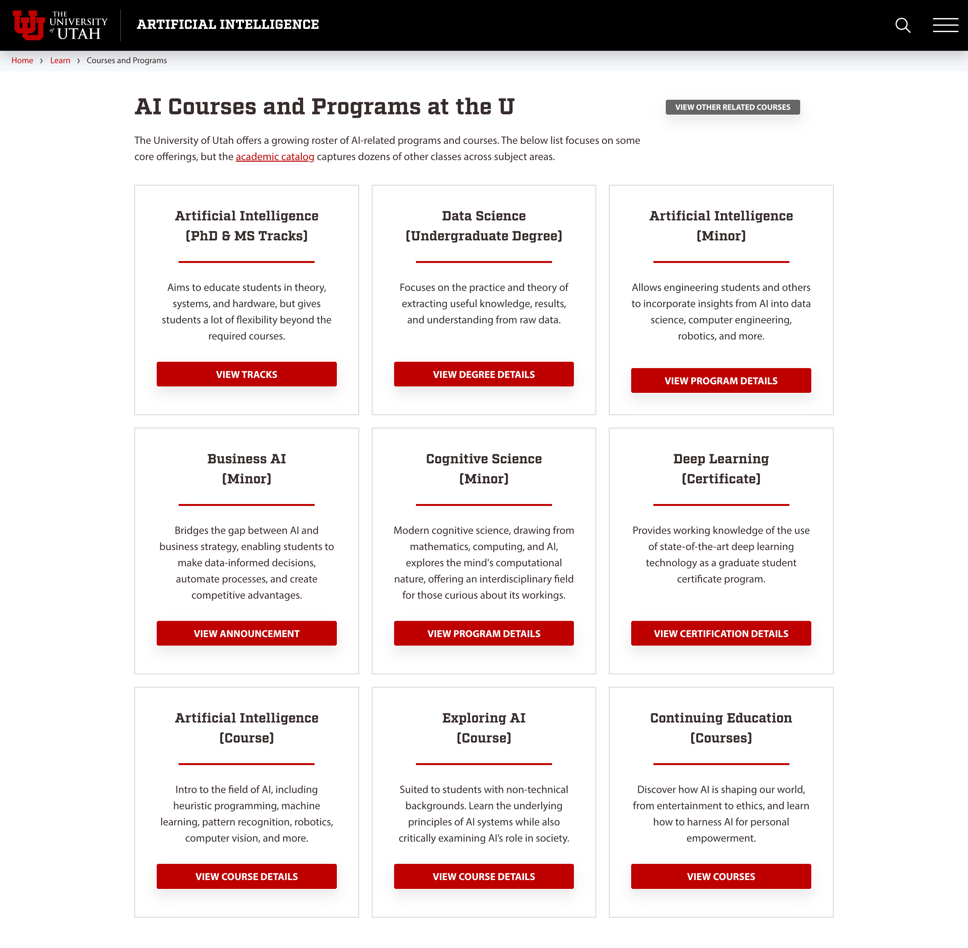
AI Courses & Programs
ai.utah.edu/learn/courses-programs.php
9 flagship programs currently listed
Includes a link to all course catalog content that mentions AI
Is your department launching a new AI program or course?
Email kelly.hermans@utah.edu for potential inclusion on this webpage
“One U” mindset: please link to this page in your promotional efforts to give students and the public a full picture of everything offered
Notes:
Manish

Slide 21

Utah AI Summit 2025
December 1–Business Builders & AI Integration: Practical Help to Integrate and Leverage AI in Your Business
Host: SeedAI
December 2–Utah's Pro-Human Leadership in the Age of AI
Hosts: Governor's Office of Economic Opportunity, Utah Department of Commerce, Nucleus Institute, and Office of Artificial Intelligence Policy
Featured Speakers: Spencer Cox (Governor), Chris Malachowsky (NVIDIA), Matthew Prince (Cloudflare), Joseph Gordon-Levitt (hitRECord)
Including interactive policy discussions and panels on deep tech, AI transformation, and collaboration

Slide 22
Ask us your questions.

