Slide 1
AI Forum University of Utah October 15th, 2025

Slide 2
Agenda
Announcements
Upcoming events
Tools and technologies
Policy/regulation updates
Education and outreach
Q&A
Notes:
Manish

Slide 3
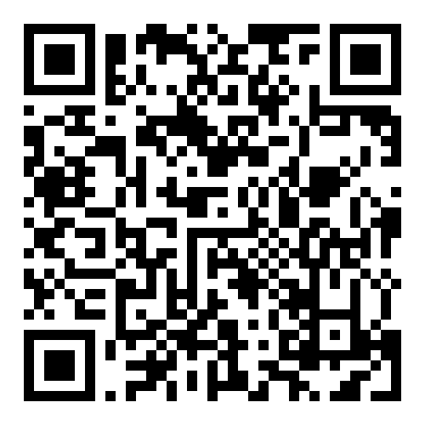
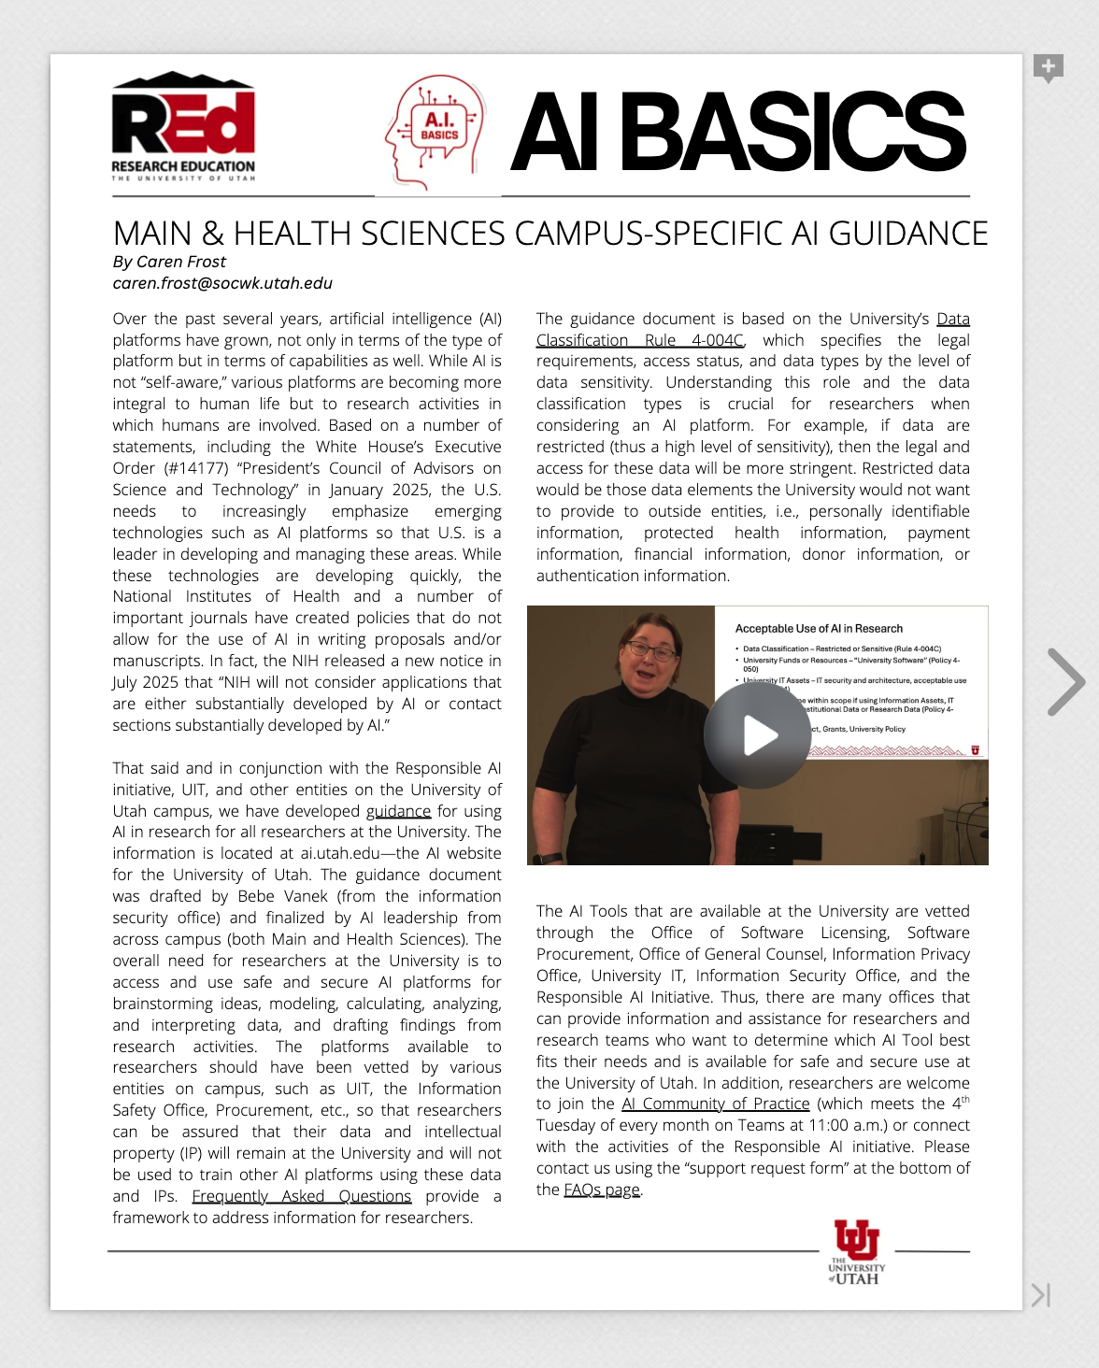
AI Basics
University guidelines and resources
Ethical considerations—bias, transparency, accountability, and environmental impact
Plagiarism and intellectual property concerns
Best practices for AI use in research
Insight on why publishing agencies have banned AI-generated content
Generative AI prompt literacy for researchers
University AI tools and strategies, including the prioritization of security and privacy and the phased rollout of approved platforms
https://online.flippingbook.com/view/436077394/
Notes:
Penny

Slide 4
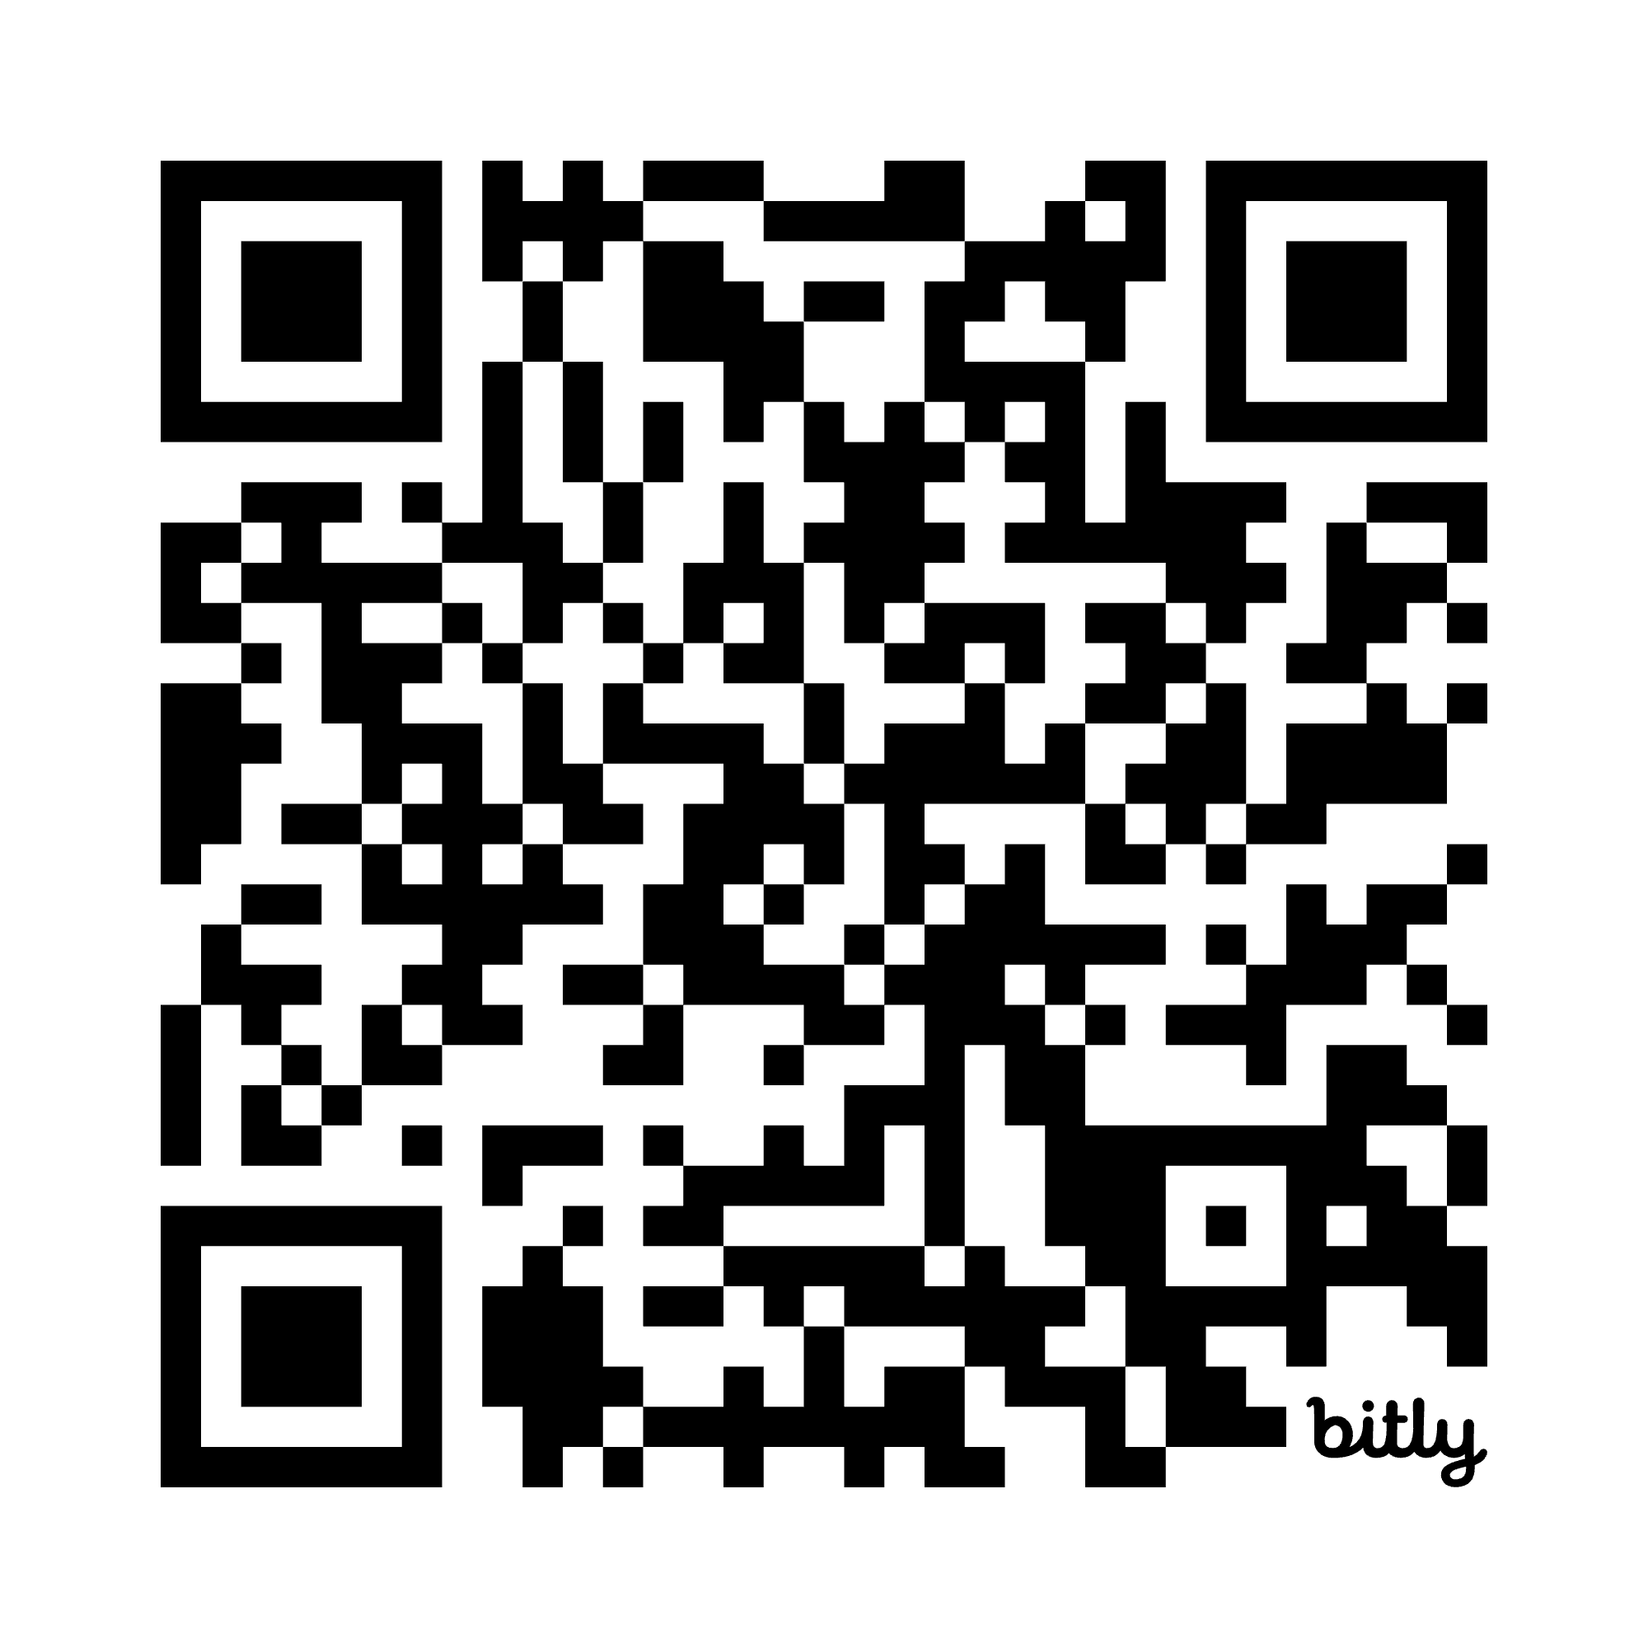
AI Tool Procurement
AI tool request form provides a framework to assess new tools at the U:
Allows for review of individual use cases
Builds awareness about existing tools, university policies and guidelines, and potential risks
Try it out and provide feedback:
Help us learn about the tools you want to use
Learn about available/approved tools.
Advance AI literacy and use across campus!
bit.ly/ai-tools-utah
Notes:
Penny

Slide 5
Announcements and Events
One-U RAI Seed Grants: rai.utah.edu/seed-grants
AI Office Hours – October 24, November 7 and 21, 12:00pm
ACP Monthly Meeting – October 28 and November 25, 11:00am
Notes:
Penny

Slide 6
AI Toolset Update
David Hawkins
Notes:
David

Slide 7

ChatGPT EDU Deployment Status
Integrating ChatGPT with university security and compliance systems (logging, monitoring, and data protection).
Finalizing an acceptable use agreement and building an onboarding portal for users to acknowledge the agreement before gaining access to ChatGPT.
Preparing support materials, documentation, and communications to guide users.
Establishing a support process with the with the Help Desk and AI Team.
Collaborating with OpenAI’s team to streamline the rollout and leverage their experience supporting other universities.
Notes:
David

Slide 8
Toolset Update
Gemini
Security Controls
NotebookLM
Google Team Security Update Needed
Security Controls
SageMaker Unified Studio
Kickoff Meeting on October 15th
15 Week Engagement with AWS
Coordinate with Google
Support Resources
Operational and Support Processes
M365 Copilot
Security Controls
Coordinate with Microsoft
Support Resources
Notes:
David

Slide 9
AI Policy and Regulation
Chris Stout and Colette Brown

Slide 10
Office of General Counsel
Understanding your license
Permissible Use
Safeguarding IP
Cost considerations
Data protection
Obligations regarding input
FERPA/HIPAA/GDPR
Confidentiality
IP limitations
Utah Higher Education Student Data Protection Act
Platform Security
Responsible use of output
Inherent bias
Truthiness
Hallucinations
Consumer Protection Laws (E.g., Colorado Artificial Intelligence Act)

Slide 11
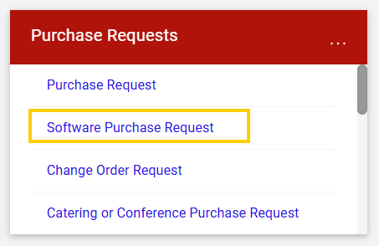
Policy and Regulation Updates
As of April 2023, all software, no matter the cost, must go through a UIT review before purchase.
Click here to read Policy 4-050A Enterprise Software and Rule 4-050B University Software.
Currently, this is conducted in UShop via the Software Purchase Request form.

Slide 12
Questions UIT Will Be Asking
Does the platform provide a user interface with login credentials?
Does the application perform a task or function?
Are we providing any kind of data to the vendor?

Slide 13
Purchasing Software and/or AI
Many software companies will provide a discounted version to try for a limited time. Having already used a specific software does not automatically make it a "single source" for purchase.
The small procurement threshold of $10,000.00 covers the whole purchase price, including any contractual terms and the cost over that time.
e.g. If a software subscription is $500/month, with the intent to use the software for the next five years, the total purchase price is $30,000 and should go through a procurement process review.
As per Utah code, contracts cannot exceed a five-year term without Director of Purchasing approval.

Slide 14
AI in Teaching & Learning
Anne Cook, Rob MacLeod, and Jon Thomas

Slide 15

Instructor Resources
CTE’s AI for Teaching page: https://cte.utah.edu/instructor-education/ai-for-teaching.php
CTE’s AI 101 course for Instructors: https://utah.instructure.com/courses/941937
Attend CTE Events/Trainings:
Mon, 11/3 via Zoom: Teaching Students to Use AI Responsibly
Spring 2026: CTLE 6960 Special Topics: Teaching with AI
Schedule an Individual Consultation at https://cte.Utah.edu

Slide 16
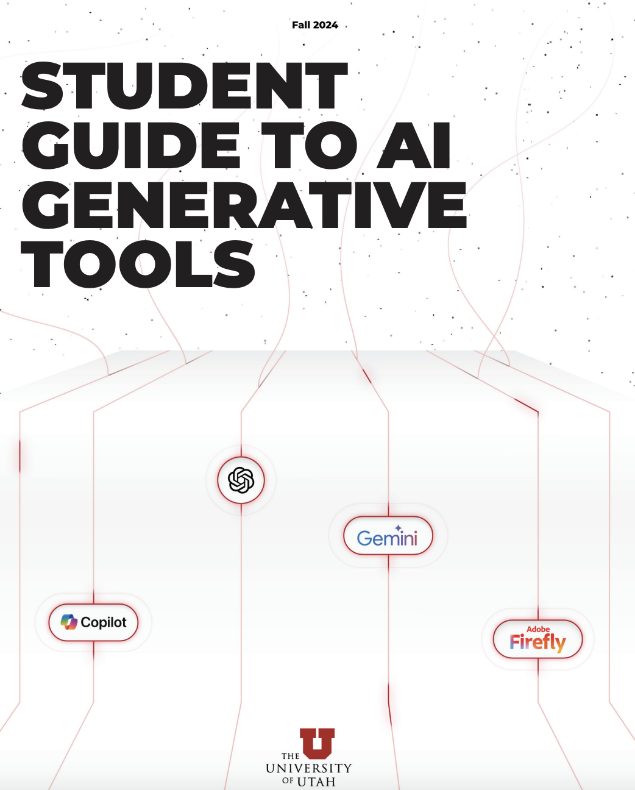
Student Learning
Clear Syllabus Statements on Expected Use of AI in Courses
https://cte.utah.edu/instructor-education/ai-for-teaching.php
Use clear rubrics to help students know WHEN and HOW AI use is ok
Student Resources
U Student AI Guide: https://cte.utah.edu/instructor-education/ai-website-content/gen_ai_2024.pdf
Marriott Library Guide: https://campusguides.lib.utah.edu/AI
UBOT by the U’s Academic Innovation and Intelligence Lab, in collaboration with The Learning Center

Slide 17
Center for Science and Math Education Exchange: AI in Education
Where Crocker Science Center Rm. 206, Noon -1
10/27: Chenglu Li (College of Ed): Gen AI: Potential tools and time for tinkering
11/17: Michael Gruenwald (College of Science): ChatGPT and Teaching

Slide 18
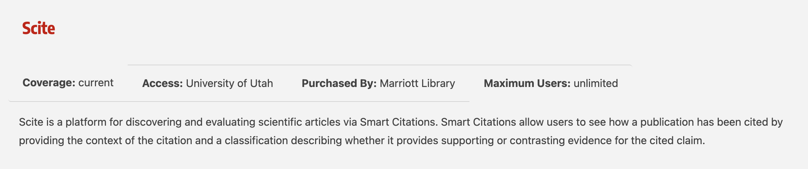
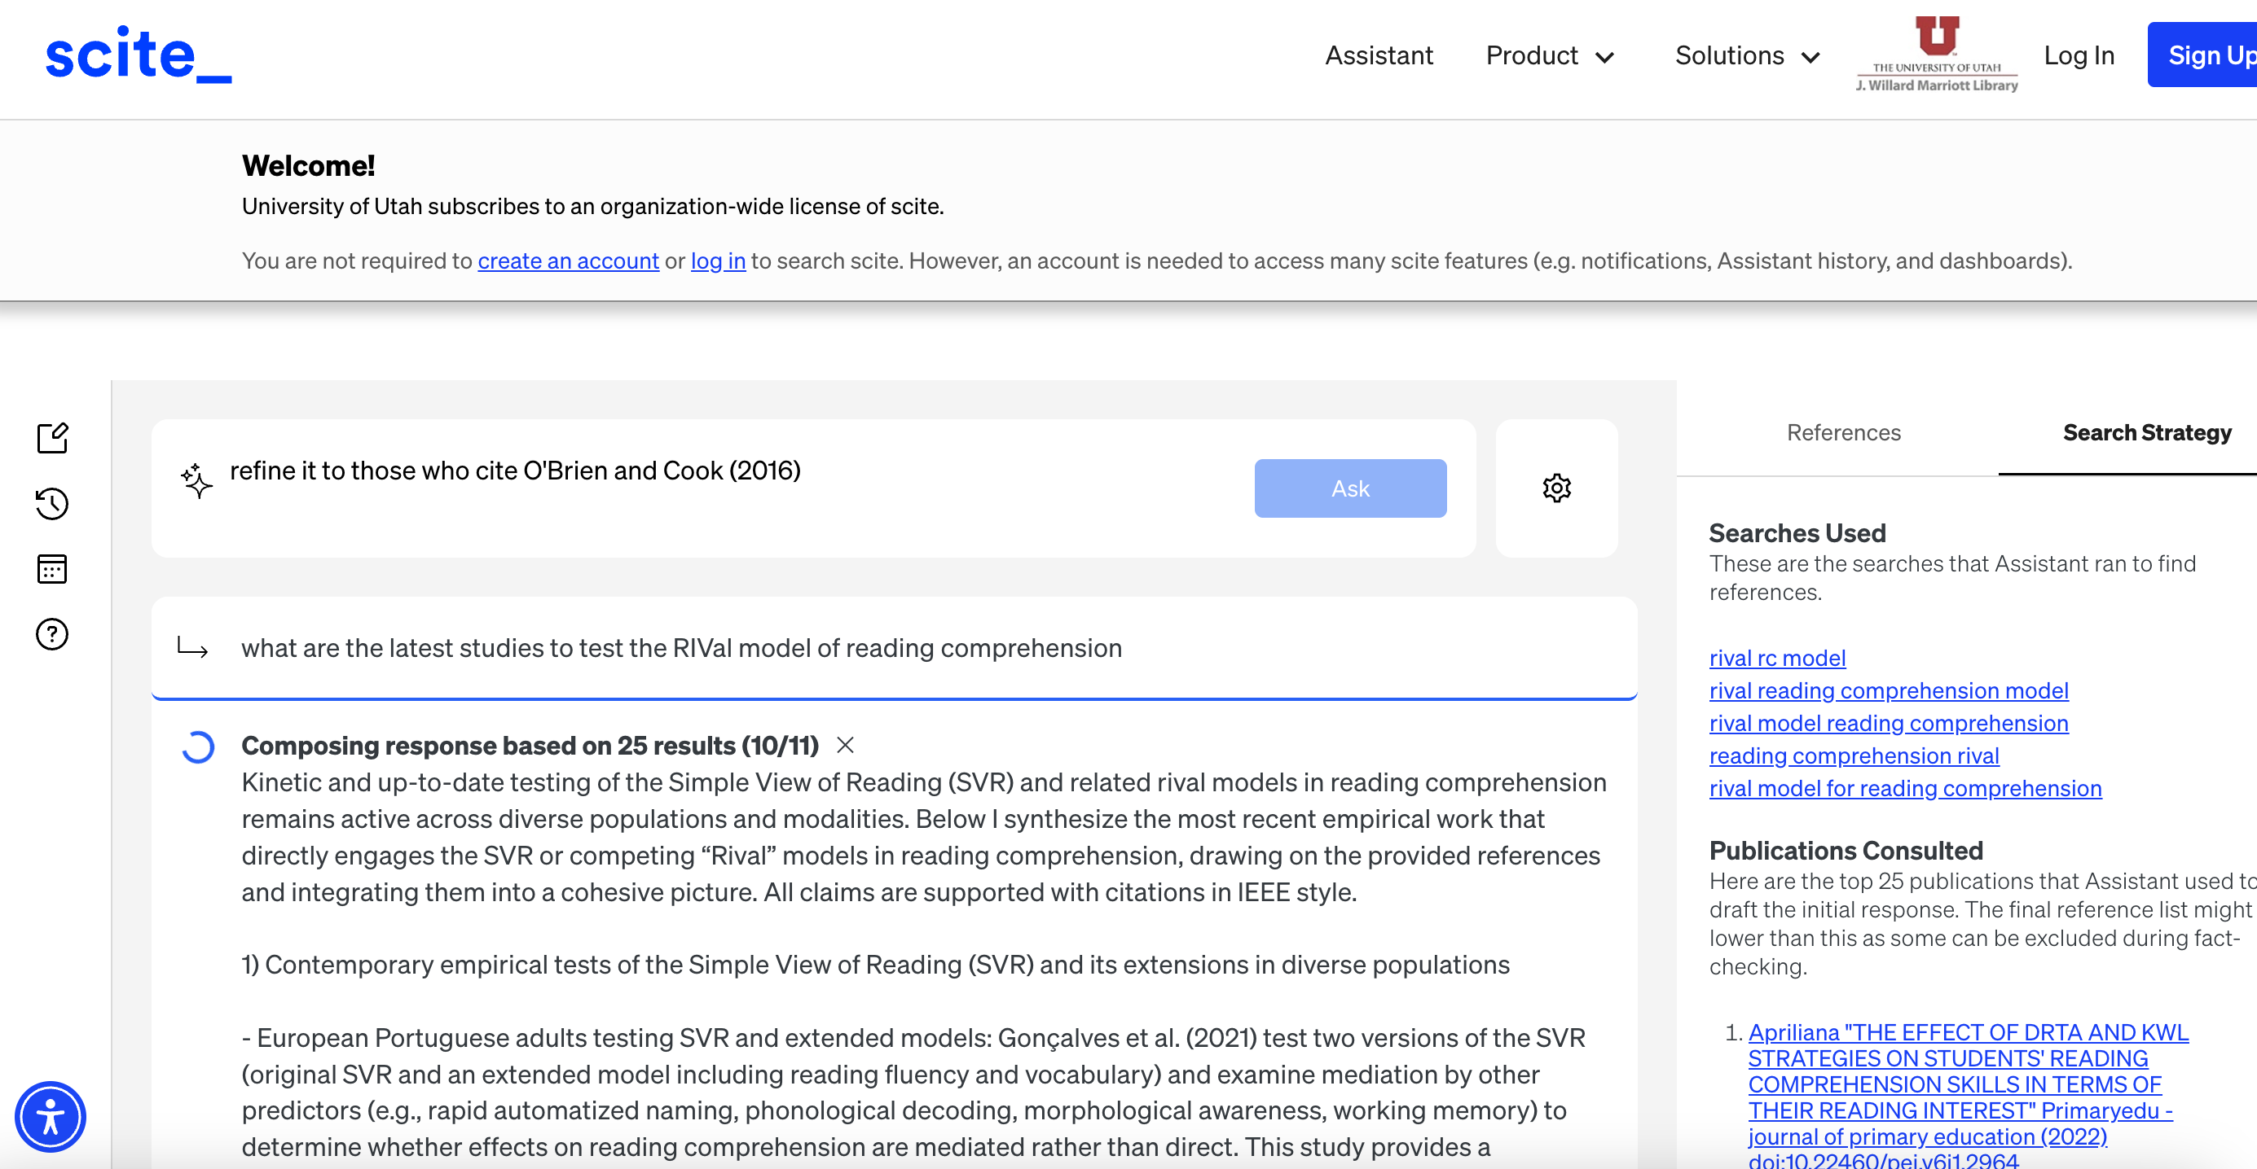
New tool through Marriott Library: Scite.AI

Slide 19
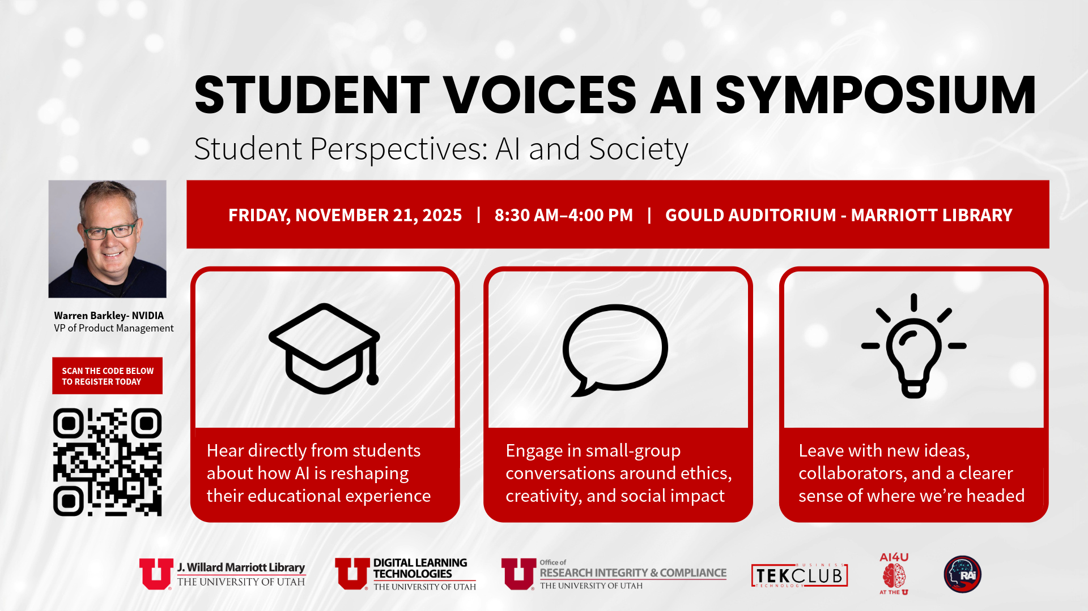


Slide 20
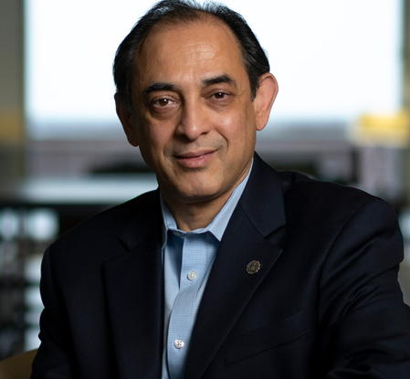

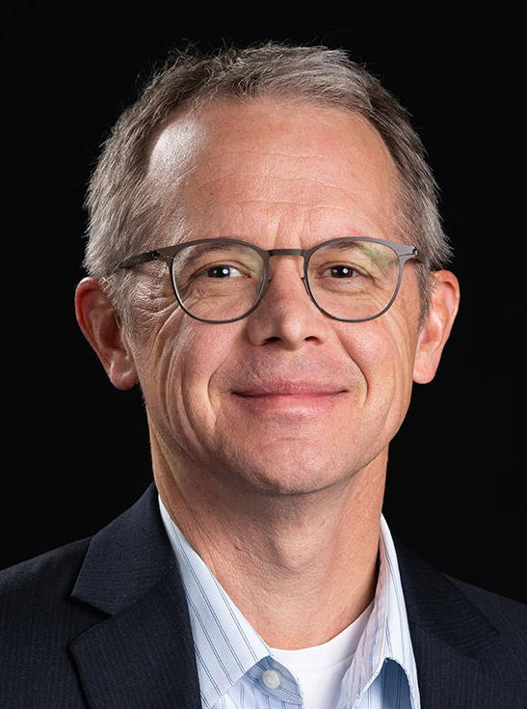

Teaching and Learning in AI Working Group
Notes:
Rob

Slide 21
Teaching and Learning in AI Goals
Serve as a Technical Resource

Slide 22
Teaching and Learning in AI Goals
Serve as a Technical Resource
Provide Curriculum Guidance and Suggestions

Slide 23
Teaching and Learning in AI Goals
Serve as a Technical Resource
Provide Curriculum Guidance and Suggestions
Curate Best Practices

Slide 24
Teaching and Learning in AI Goals
Serve as a Technical Resource
Provide Curriculum Guidance and Suggestions
Curate Best Practices
Provide Campus-wide Support with Flexibility

Slide 25
Teaching and Learning in AI Structure
Support Student AI Literacy
T&L AI Working Group

Slide 26
Teaching and Learning in AI Structure
Improve Teaching Practice
Support Student AI Literacy
T&L AI Working Group

Slide 27
Teaching and Learning in AI Structure
Improve Teaching Practice
Support Student AI Literacy
T&L AI Working Group
Train AI for Data Science & Analysis

Slide 28
Teaching and Learning in AI Structure
Improve Teaching Practice
Support Student AI Literacy
T&L AI Working Group
Explore New Ideas
Train AI for Data Science & Analysis

Slide 29

Curriculum Development I
Technical Background
Domain-Specific Applications

Slide 30
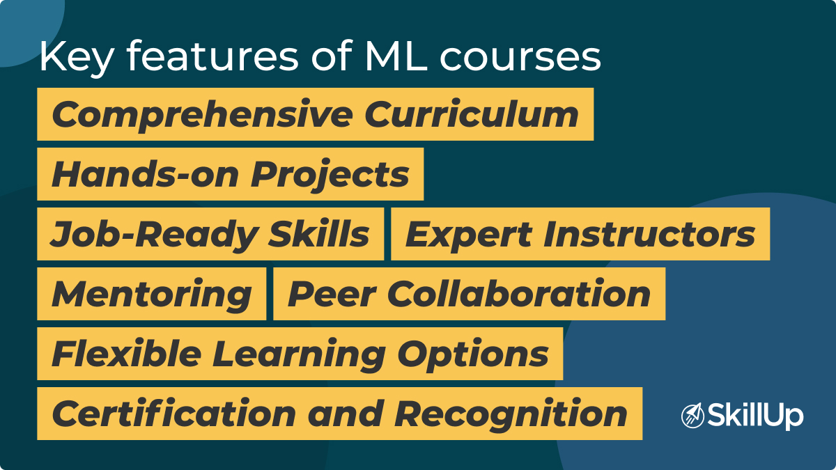
Curriculum Development II

Slide 31

Next Steps
jon.thomas@utah.edu
chong.oh@eccles.utah.edu
lienfan.shen@utah.edu
Anne.Cook@utah.edu
j.andrus@utah.edu
n.friedman@utah.edu
codrina.rada@economics.utah.edu
Darryl.Butt@utah.edu
rebecca@math.utah.edu
jennifer.gervais@utah.edu
jessica.demolder@utah.edu
Lance.Finch@law.utah.edu
Preston.Tanner@utah.edu
melissa.mendelson@utah.edu
melody.krahulec@nurs.utah.edu
sneha.kasera@utah.edu
eilbeck@genetics.utah.edu
david.stroupe@utah.edu

Slide 32
Next Steps
jon.thomas@utah.edu
chong.oh@eccles.utah.edu
lienfan.shen@utah.edu
Anne.Cook@utah.edu
j.andrus@utah.edu
n.friedman@utah.edu
codrina.rada@economics.utah.edu
Darryl.Butt@utah.edu
rebecca@math.utah.edu
jennifer.gervais@utah.edu
jessica.demolder@utah.edu
Lance.Finch@law.utah.edu
Preston.Tanner@utah.edu
melissa.mendelson@utah.edu
melody.krahulec@nurs.utah.edu
sneha.kasera@utah.edu
eilbeck@genetics.utah.edu
david.stroupe@utah.edu
We want to hear from you! Look for a submission form soon! https://ai.utah.edu/teach

Slide 33
Ask us your questions.

